Slide 1

Standard Operating Procedure for submitting e-Bid under two cover system.

Slide 2
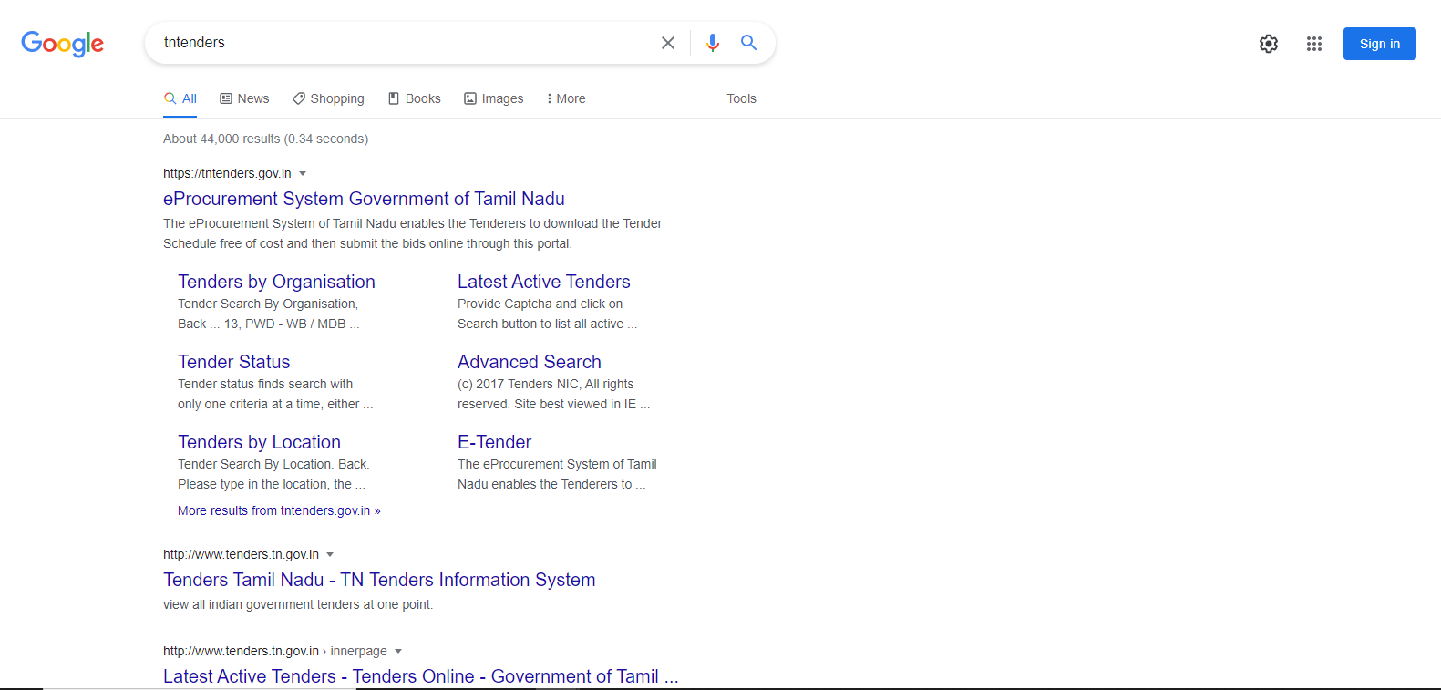
Enter url: www.tntenders.gov.in
or
Search “tntenders” in Google
Click on this Link
Click Here

Slide 3
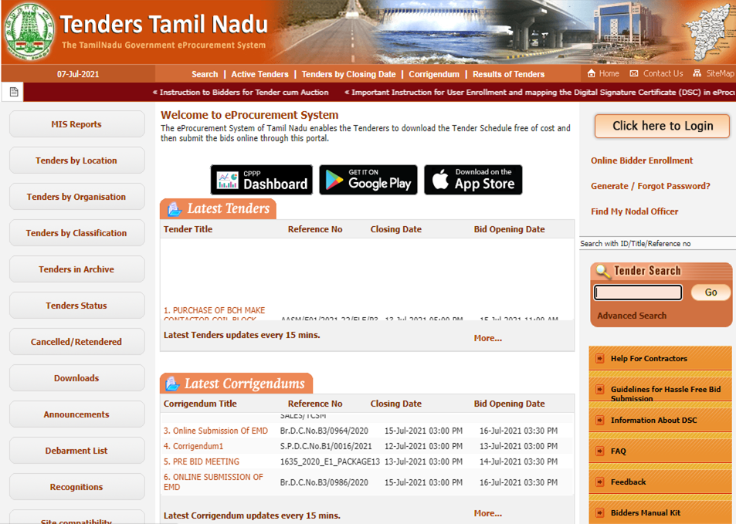
Click here

Slide 4
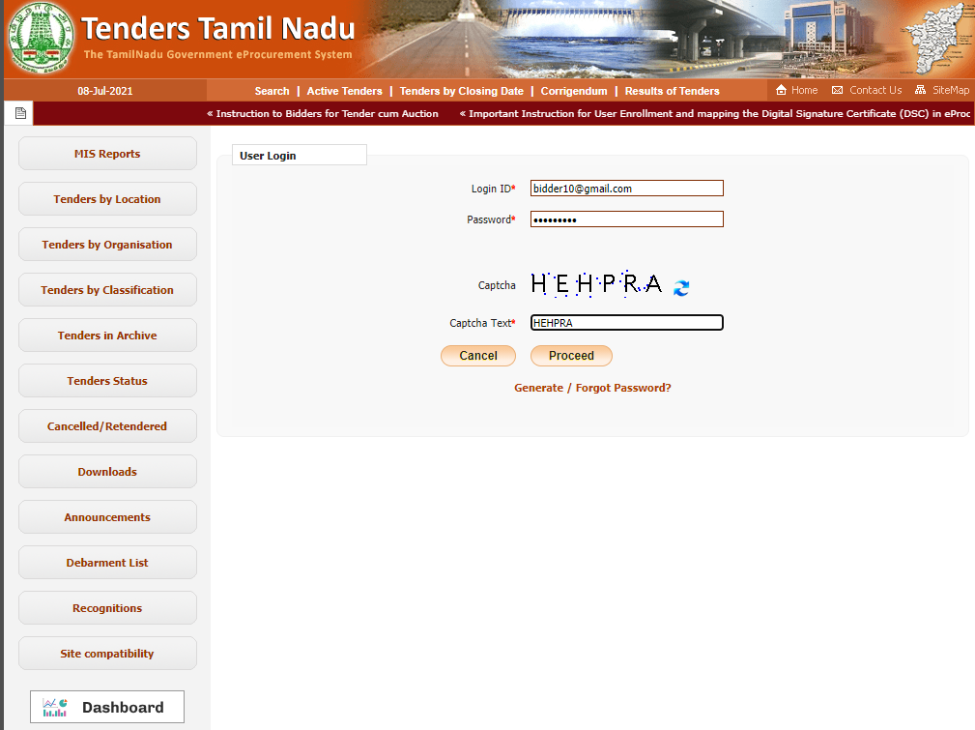
1.Enter your credentials here
2.Click here

Slide 5
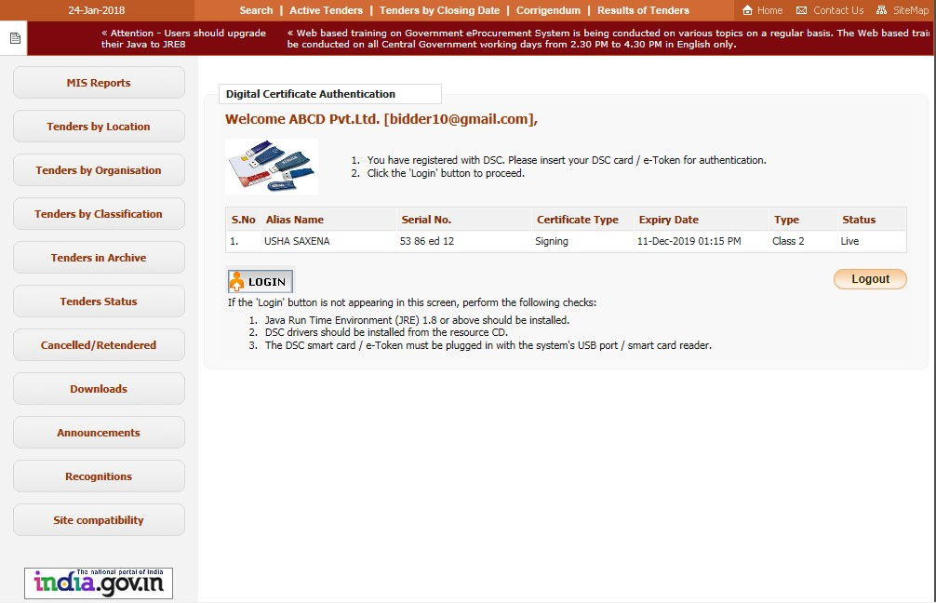

Click here to login using DSC

Slide 6
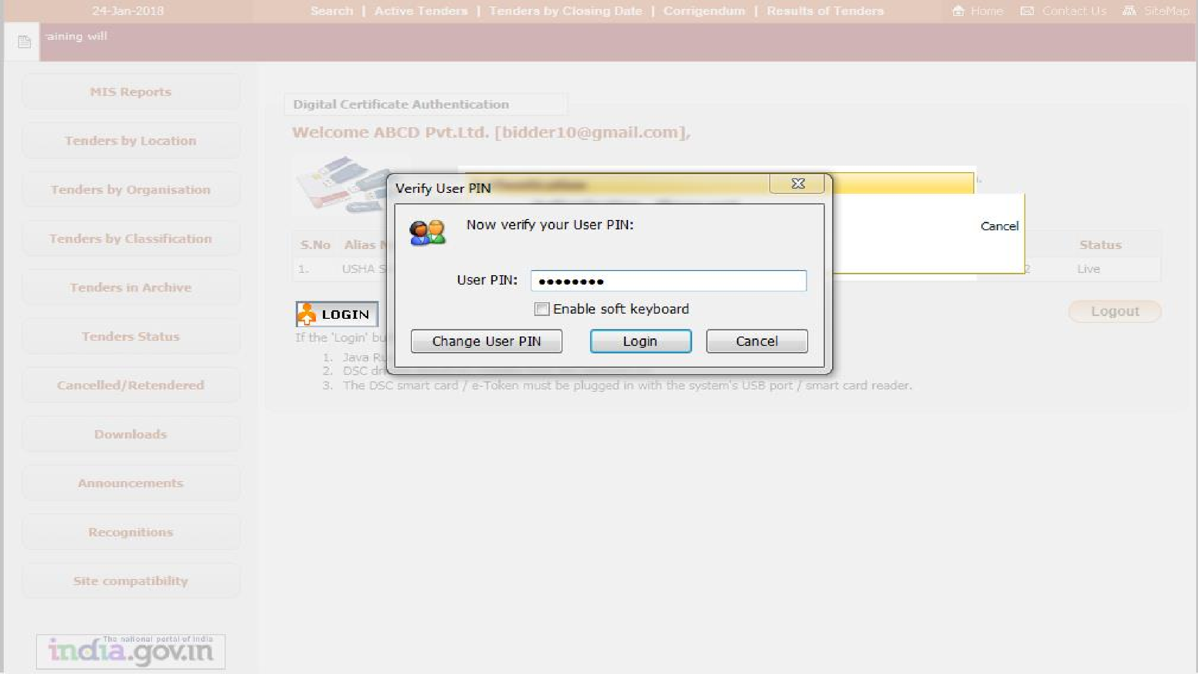


1. Enter DSC Token password
2. Click Login

Slide 7
Bid Submission

Slide 8
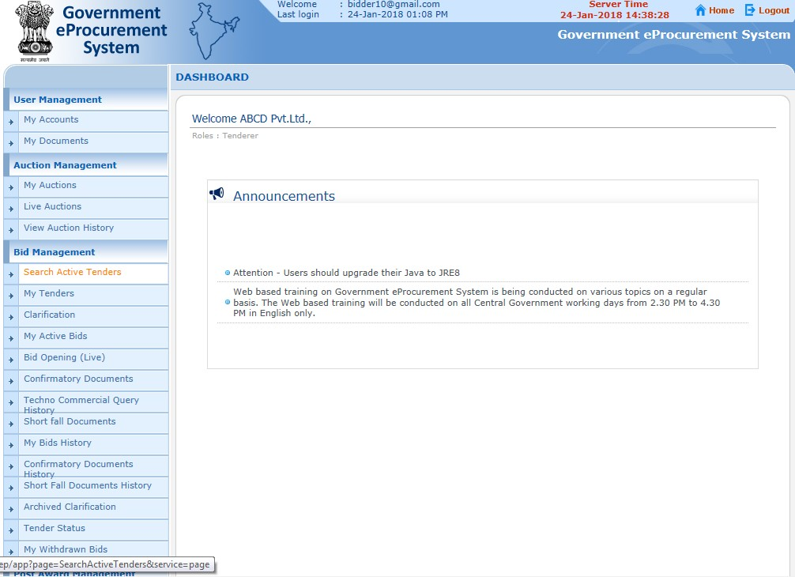

Click here to Search the Active Tenders

Slide 9
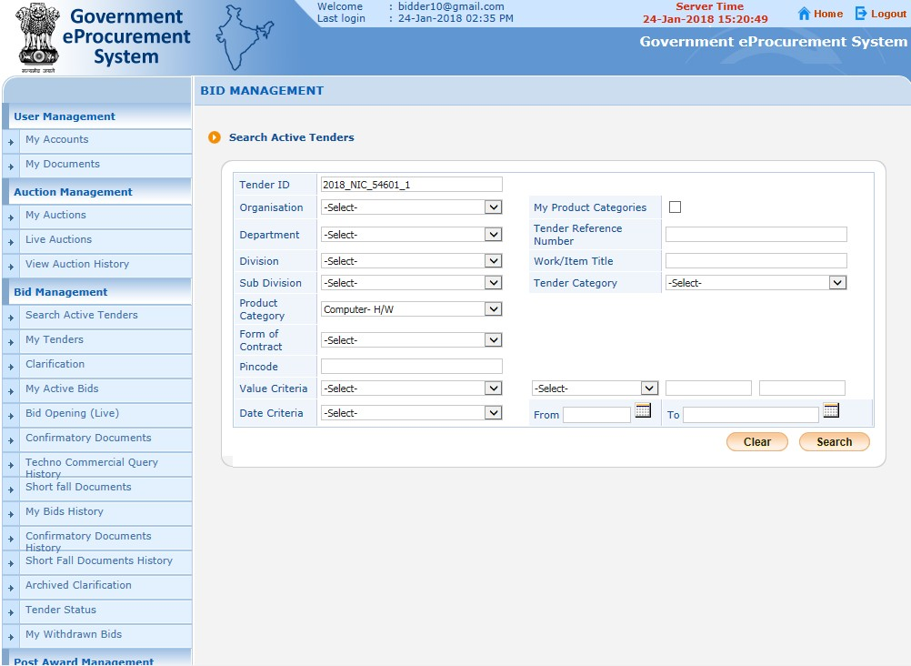


1. Enter Tender ID or Keyword
2. Click Search

Slide 10
My Tenders
A tender searched using any search criteria mentioned can be made as favorite.
Check the field under favorite and click Save. The tender is made as your favorite.
The tenders gets moved to My Tenders.
Click My Tenders from the menu in the left side of the
page.
The tenders made as favorite gets displayed.
Click View to view the details of a particular tender.

Slide 11
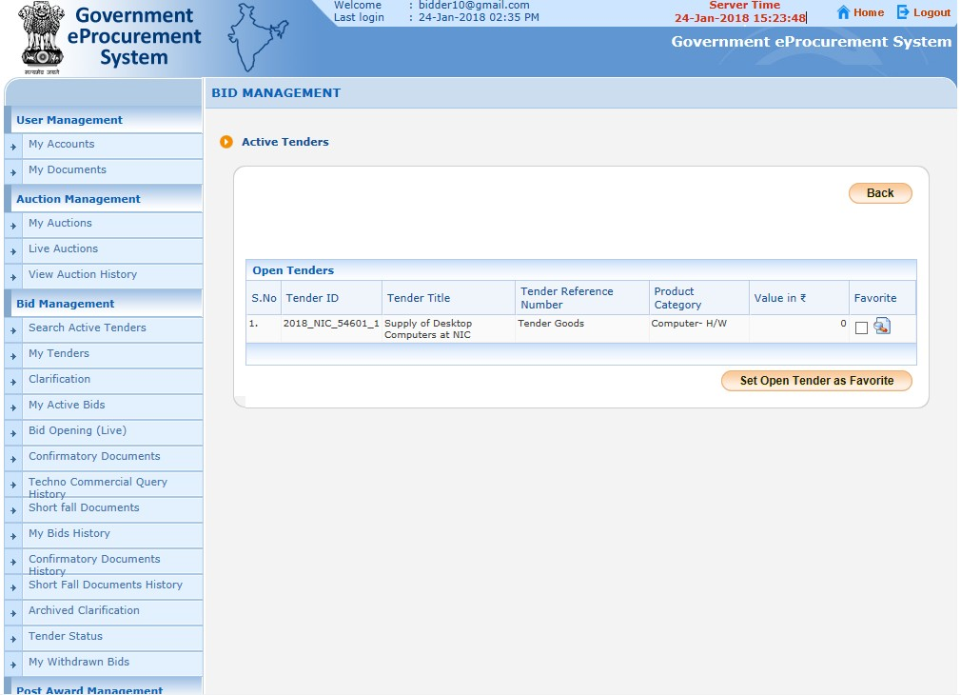
Click here to view tender details

Slide 12
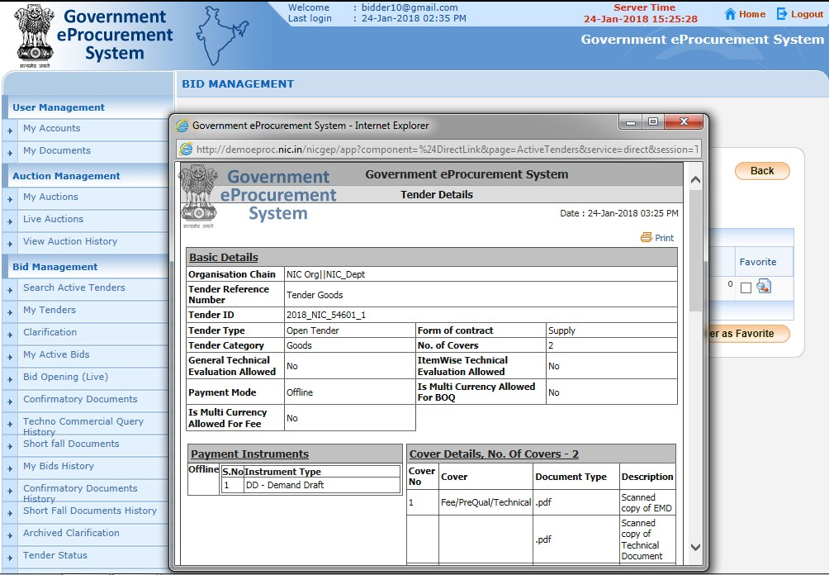

Tender Details

Slide 13
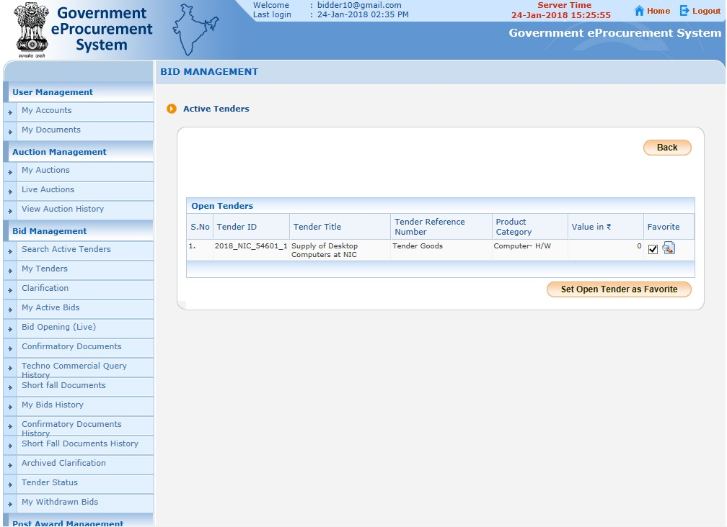


1. Click the check box to make as favorite
2. Click Set Open Tender as Favorite
After setting the Tender as Favorite, bidder will get all the updated information related to that Tender through mail and sms

Slide 14
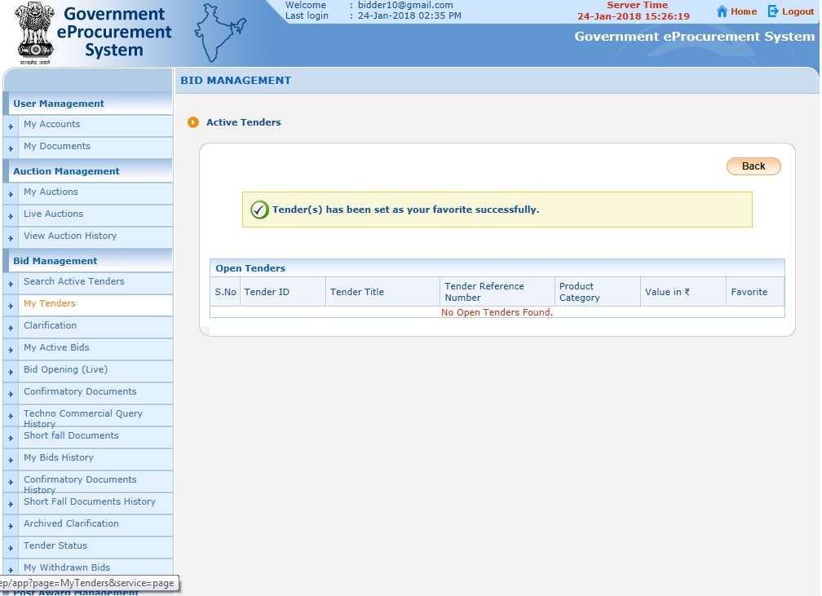


Acknowledgement for tender set as favorite
Click
My Tenders

Slide 15
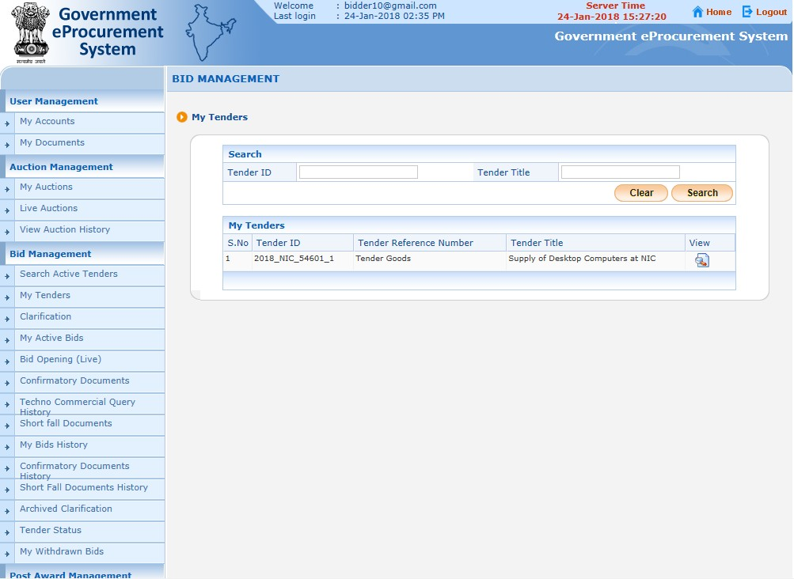

List of tenders moved from Search Active Tenders
Click here to view Tender details and Start the Bid Submission

Slide 16
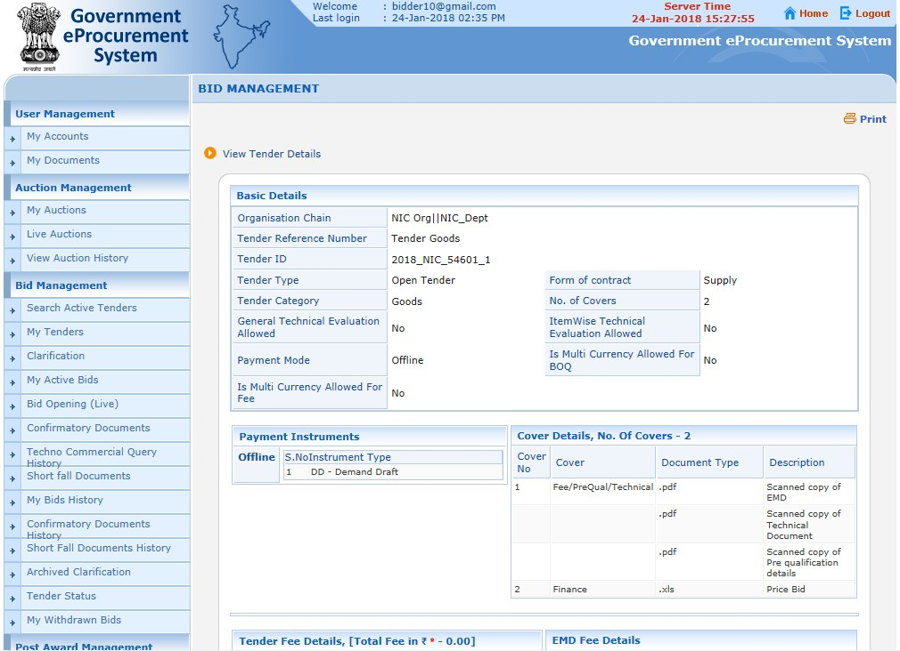
Tender Details Page 1

Slide 17
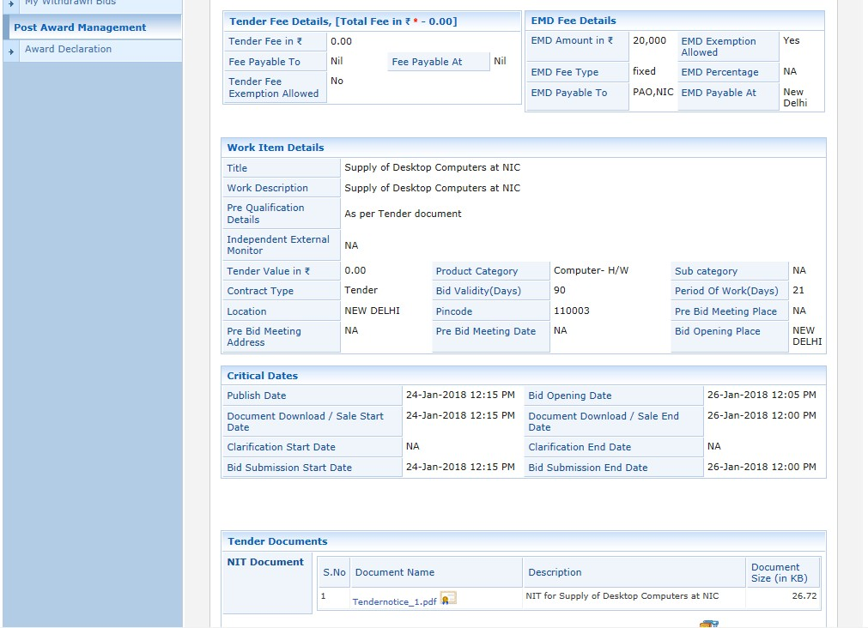

Tender Details Page 2
Click here to download the NIT

Slide 18
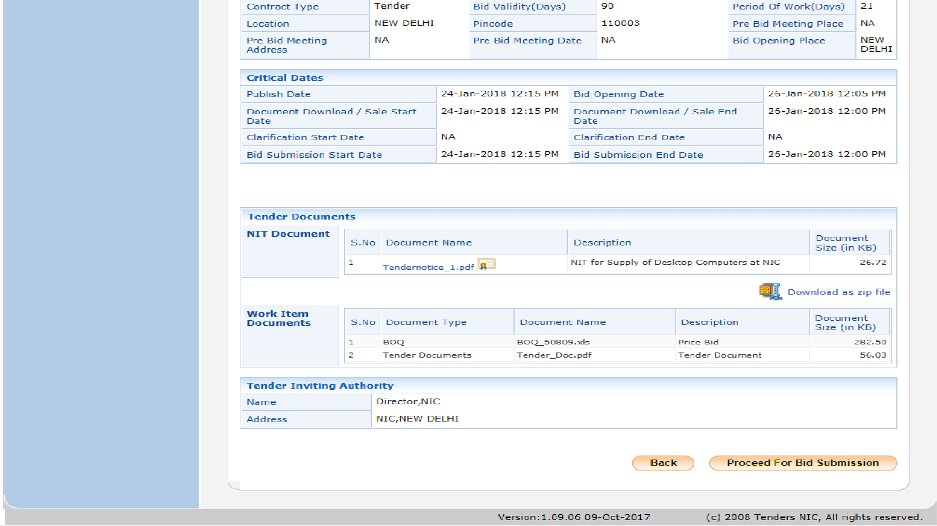


Tender Details Page 3
Click here to download the BoQ and Tender document
Click Proceed for Bid Submission

Slide 19
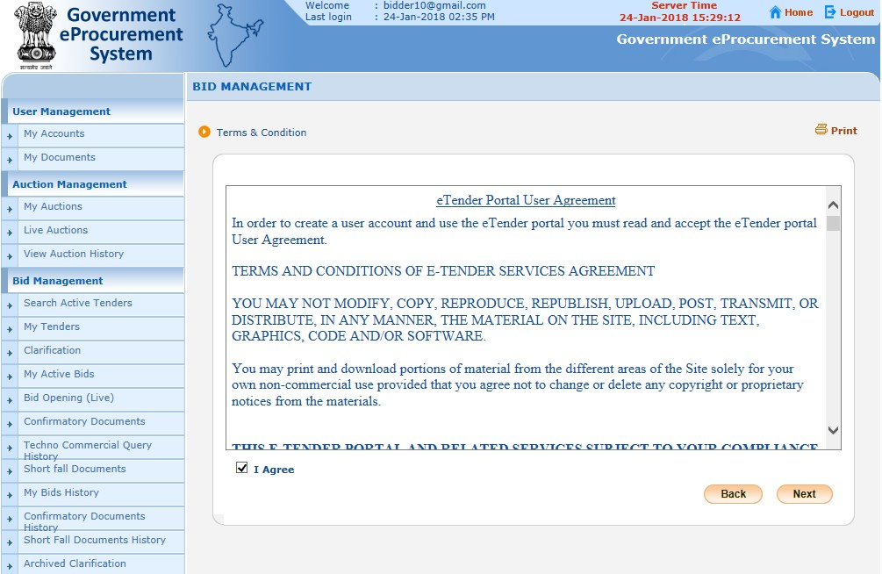


Read the Terms of Conditions
1. Select I Agree
2. Click Next

Slide 20
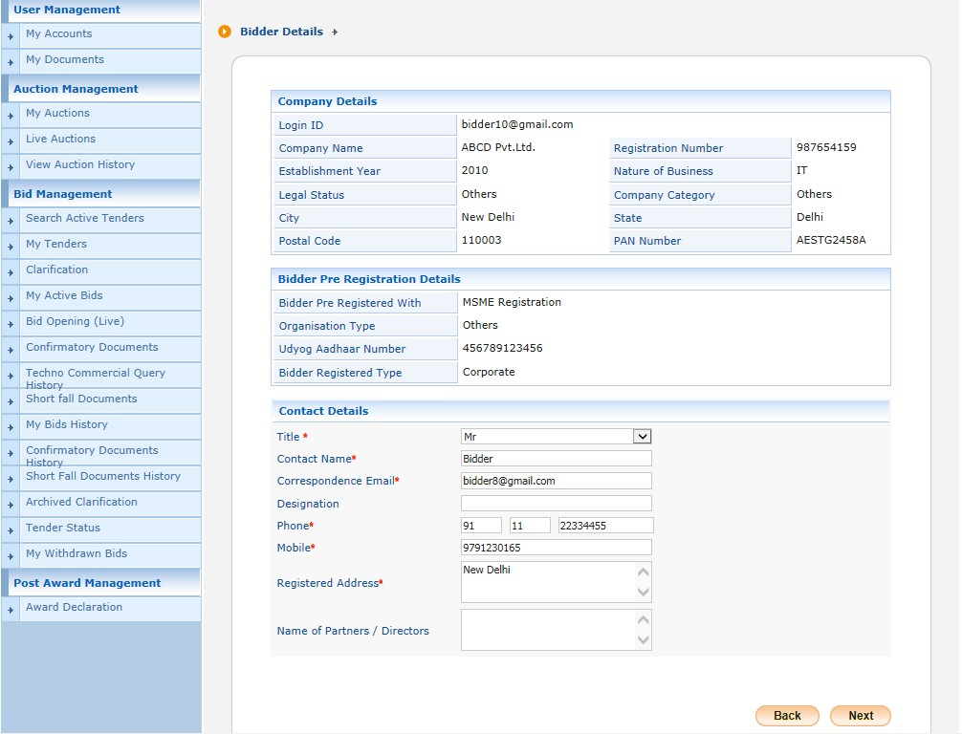

Here you can change your information if need
Click Next

Slide 21
General Information to the Bidder
before processing
Scan all the documents at 75 to 100 DPI.
Ensure the system is protected with anti-virus.
Bid Submission involves the following steps,
  Entering the fee details( if there is no tender fee the system directs to the EMD details page.)
  Entering the EMD details
  Uploading of Bid Documents
  Bid Confirmation

Slide 22
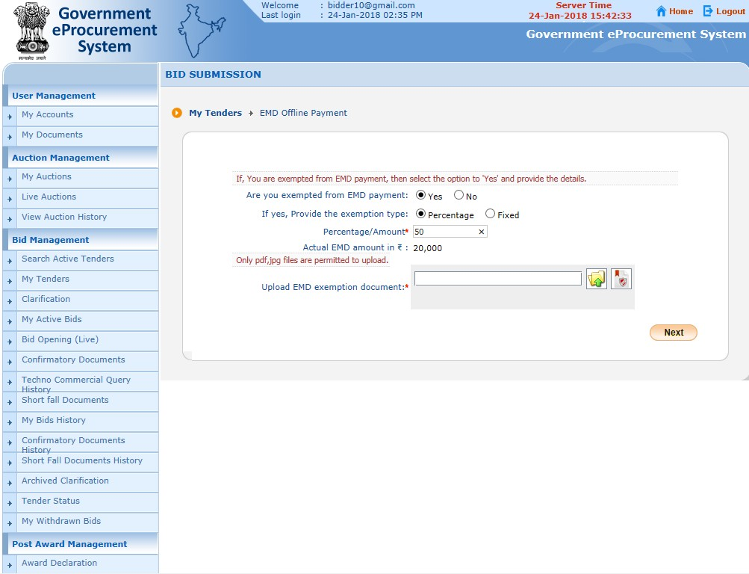

Select EMD exemption type

Slide 23



Choose EMD Exemption
type
Enter Exempted
Percentage/ Amount

Slide 24
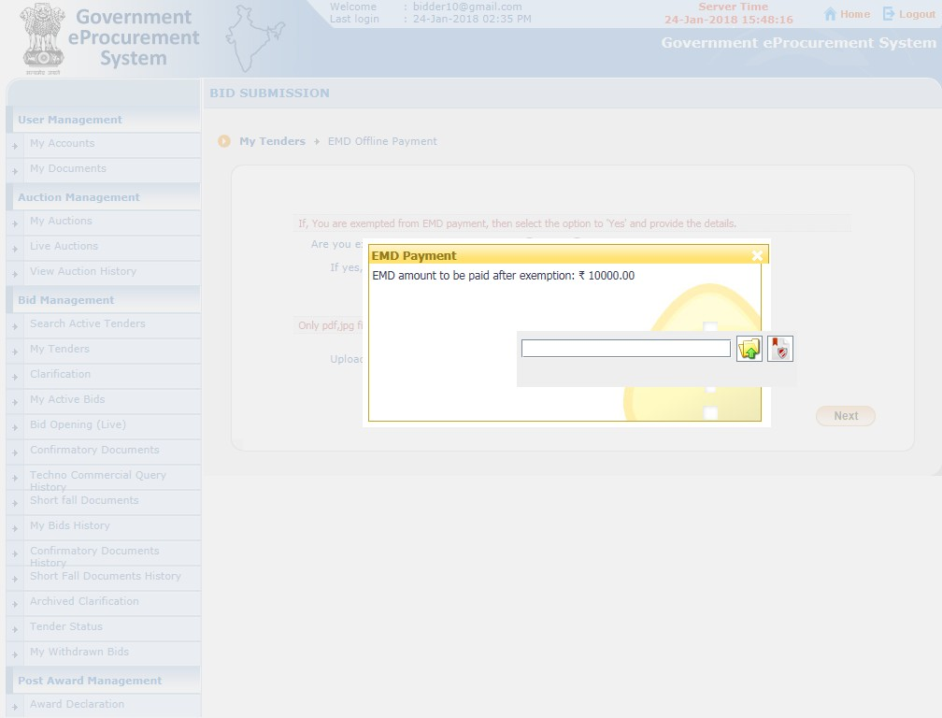

EMD amount to be paid after exemption

Slide 25

Upload EMD exemption document

Slide 26
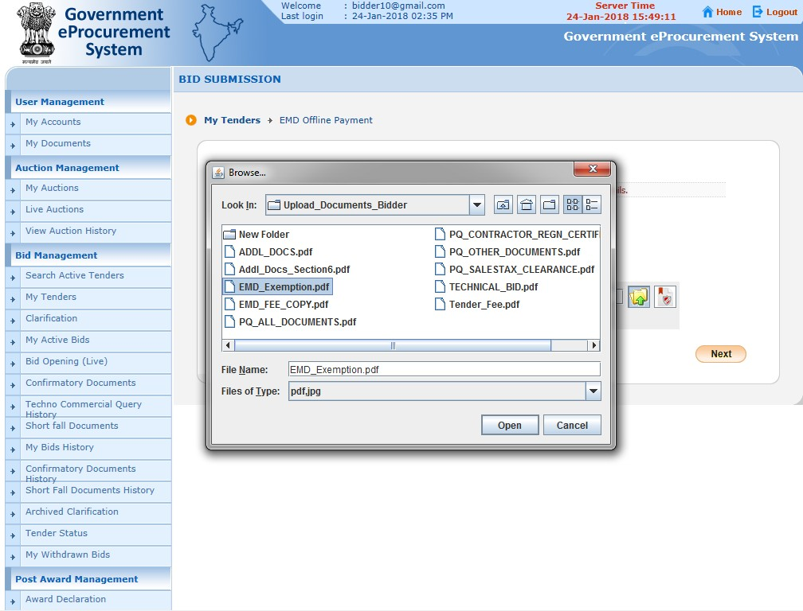


Select the document
Click open

Slide 27
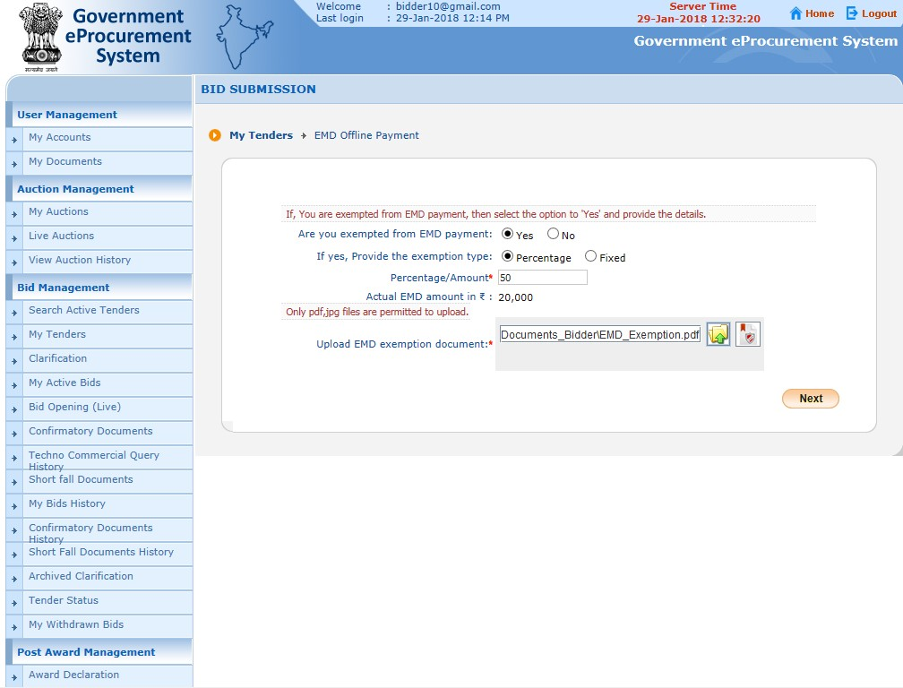

Click here to sign the Document Digitally

Slide 28
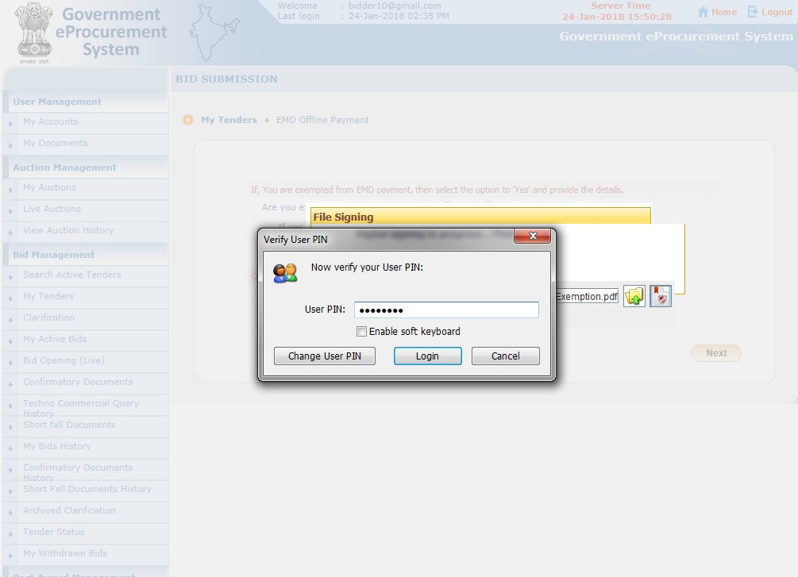


Enter DSC password
Click Login

Slide 29
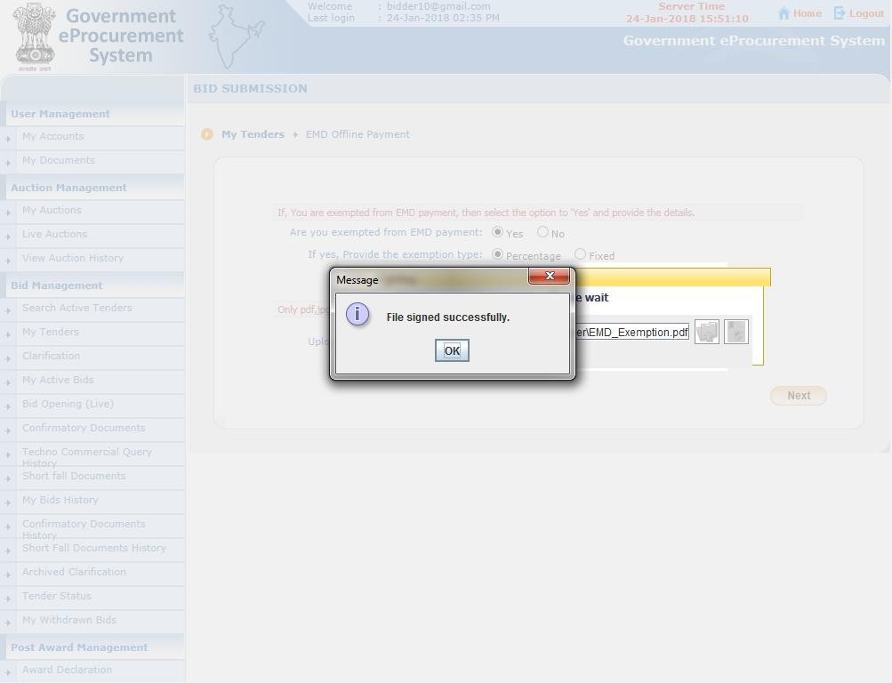

Click ok

Slide 30


Click Next

Slide 31
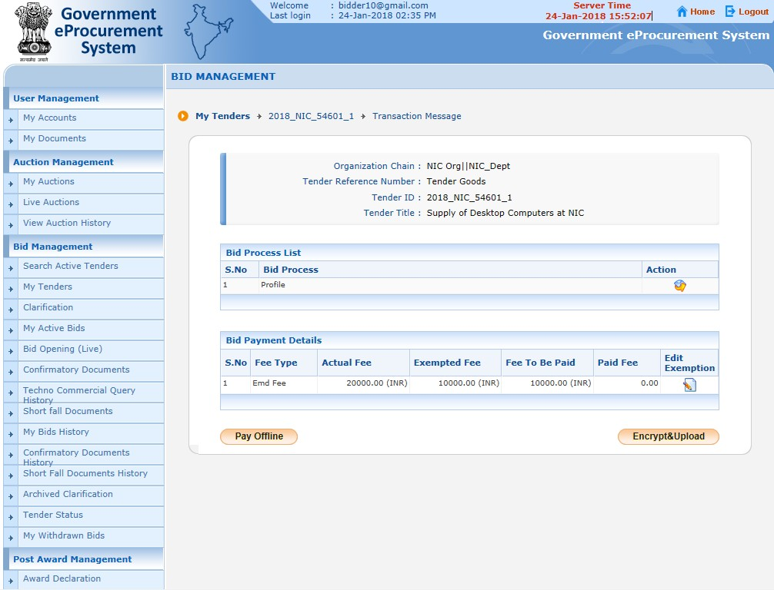

Click Pay Offline

Slide 32
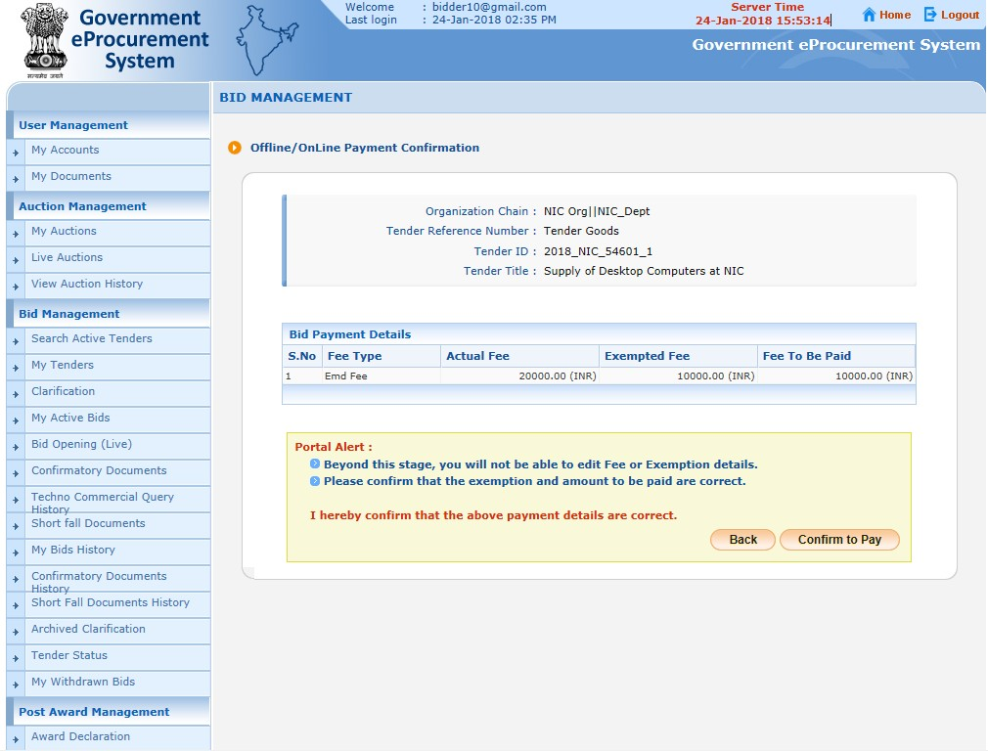

Click Confirm to Pay

Slide 33
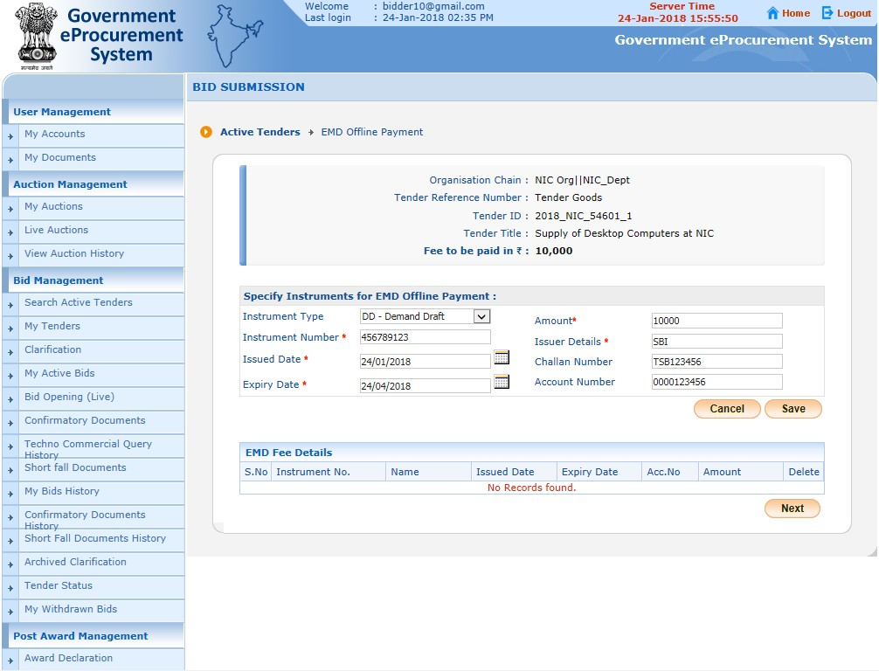


Enter EMD Fee Details
Click Save

Slide 34
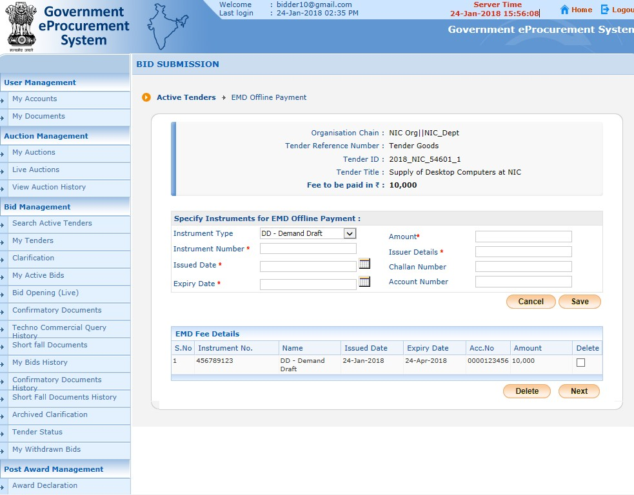

Click Next

Slide 35
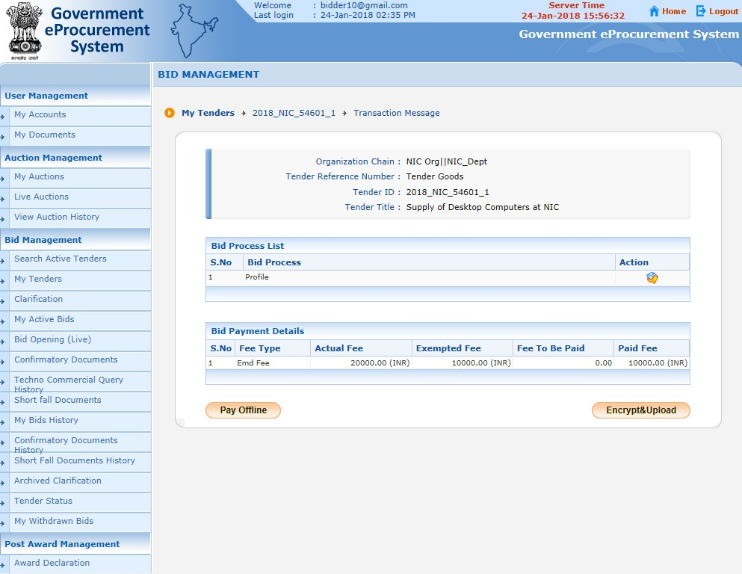

Click Encrypt & upload

Slide 36
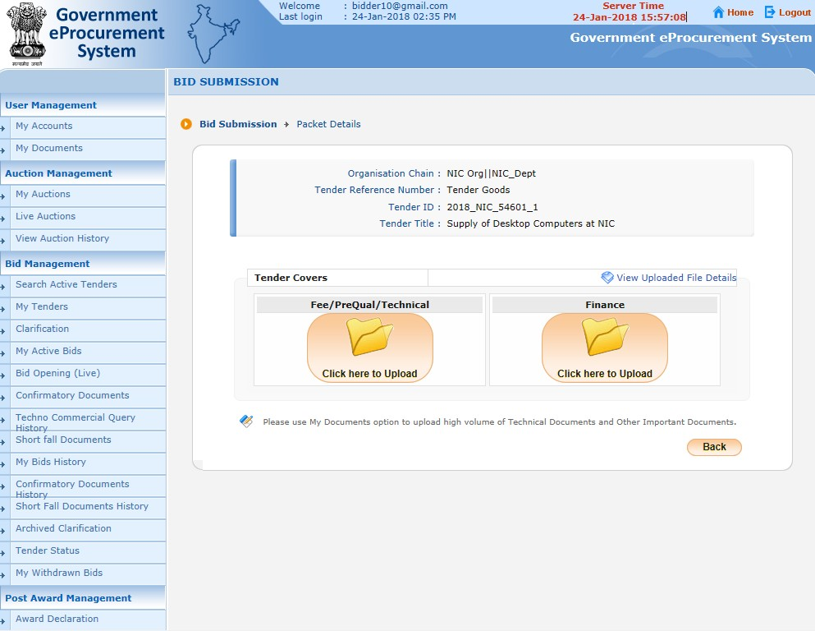
Click here to upload the technical bid documents in the first cover

Slide 37
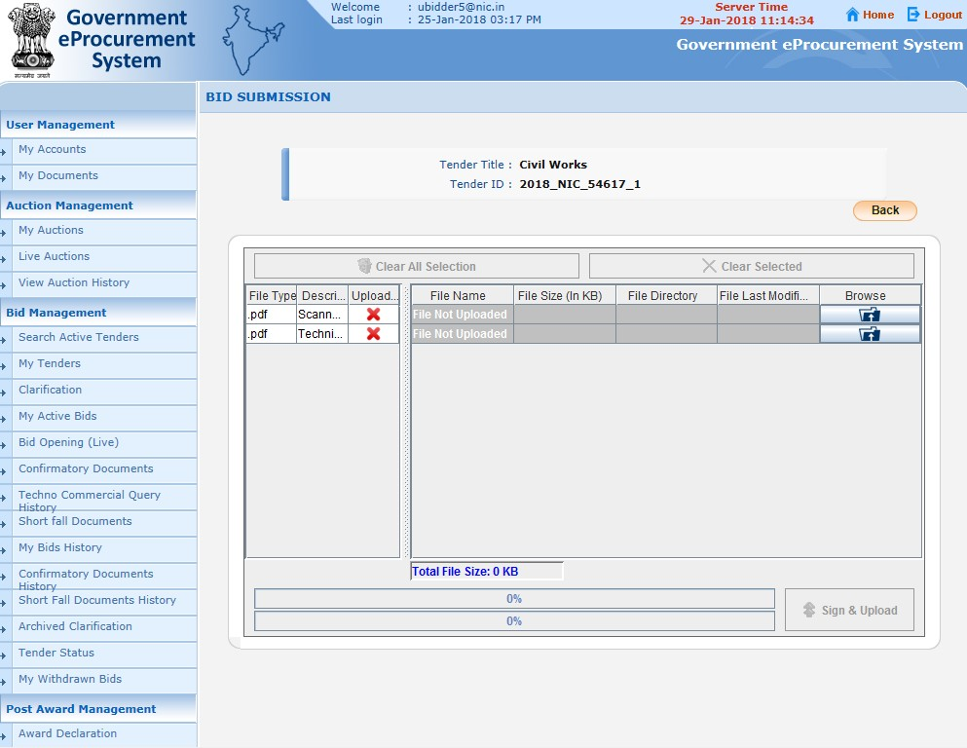

Click browse to upload Fee document

Slide 38
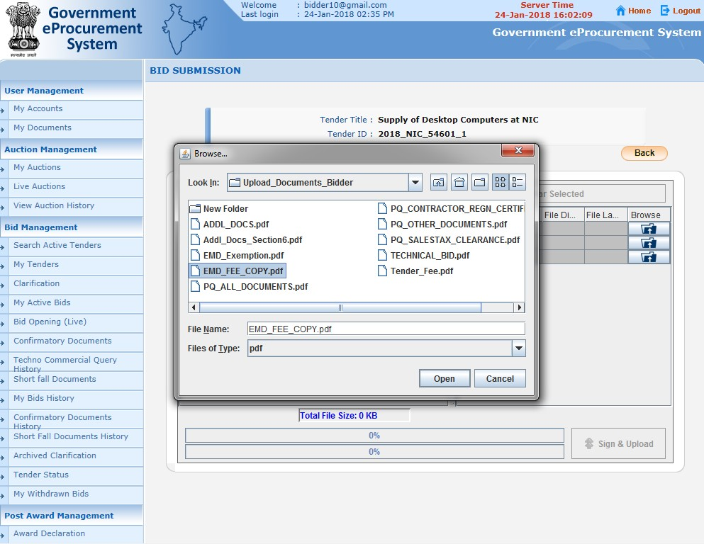


1.Select the fee document
2.Click
Open

Slide 39
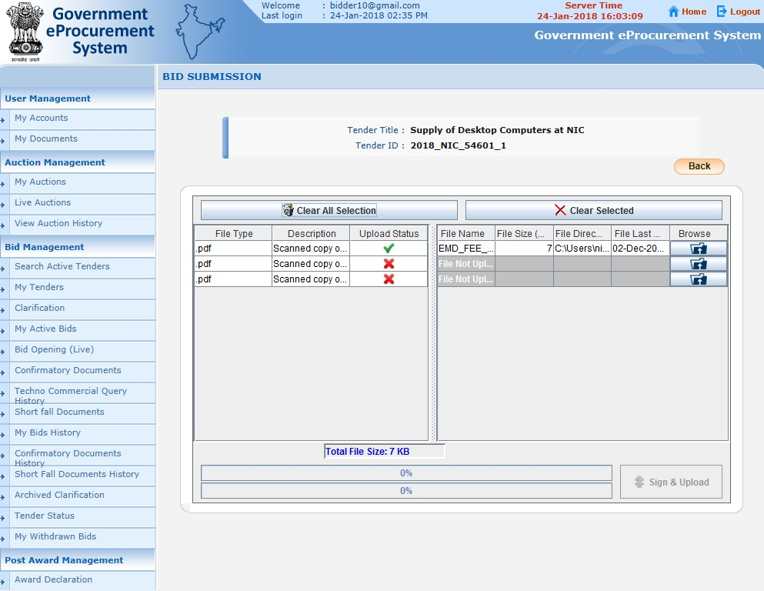

Selected file uploaded

Slide 40
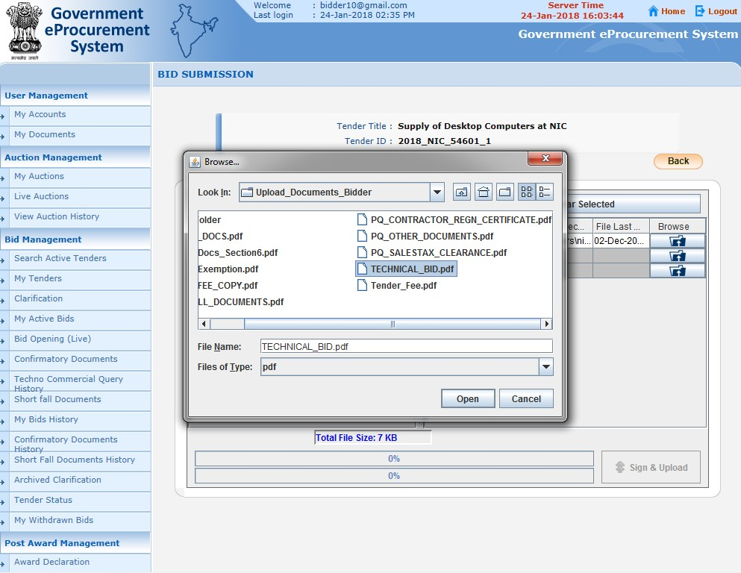


1.Select the file
2.Click
Open

Slide 41
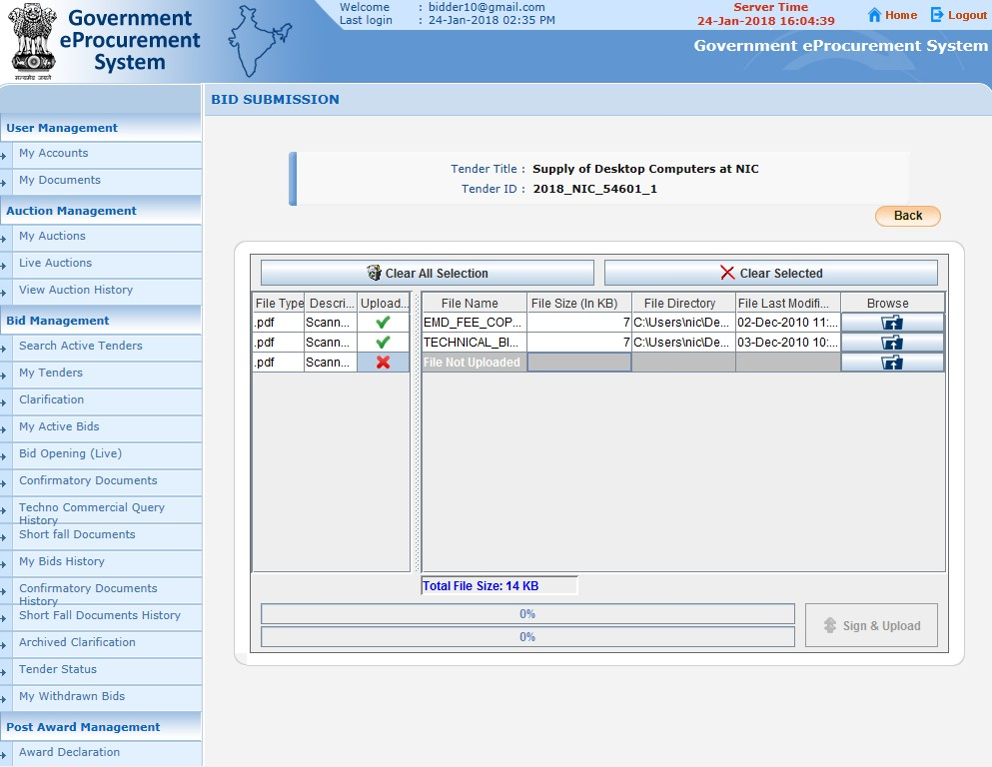

Selected file
uploaded

Slide 42
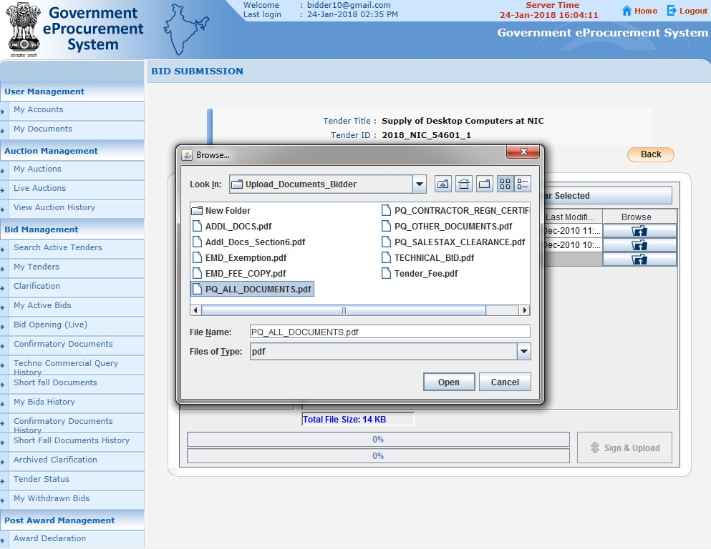


1.Select the file
2.Click
Open

Slide 43
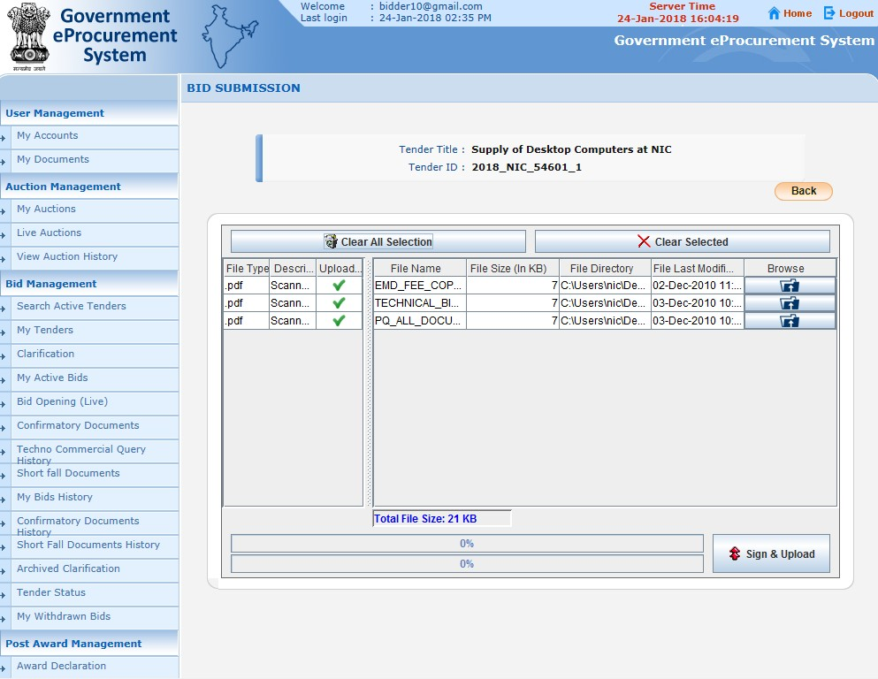

Selected file uploaded
Click Sign & Upload

Slide 44
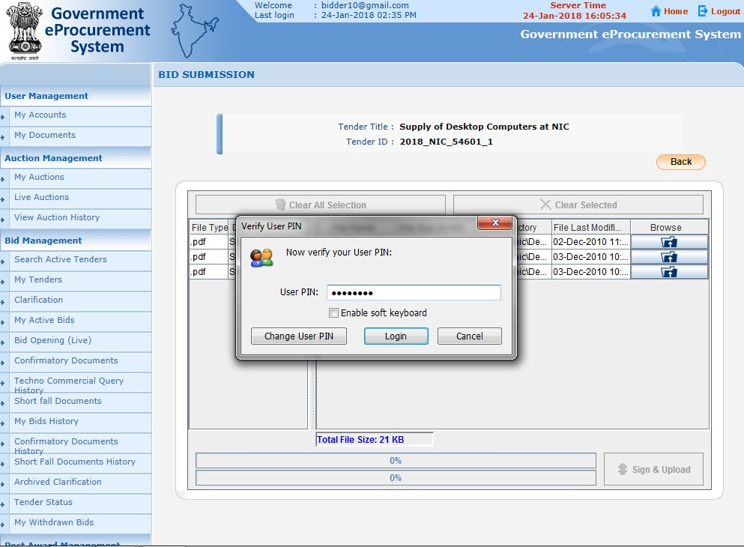


Enter DSC password
2.Click Login

Slide 45
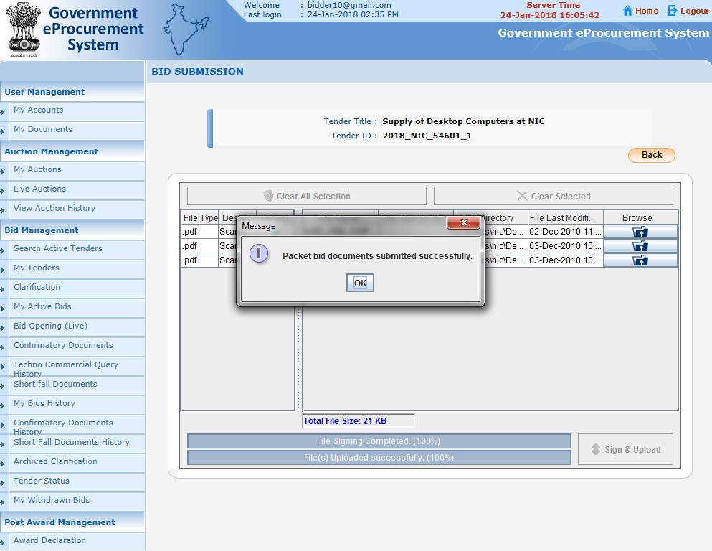

Click
ok

Slide 46
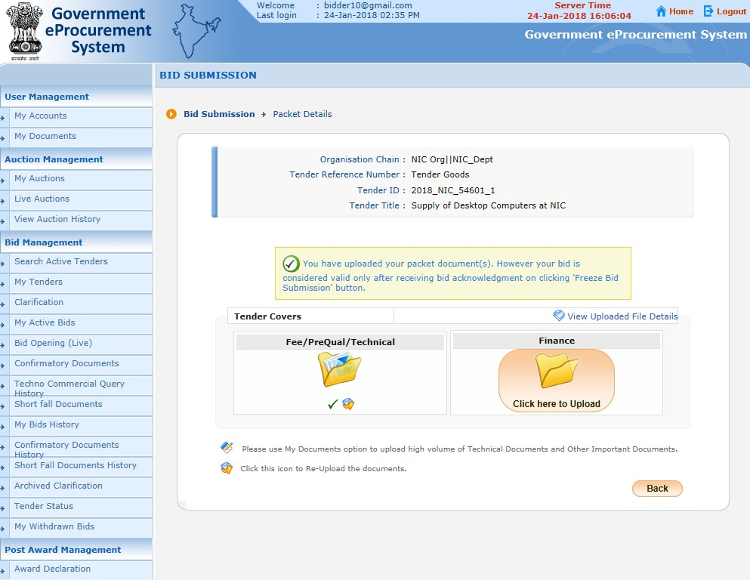


Tick mark indicates cover documents have been submitted Successfully
Click here to Upload Finance cover

Slide 47
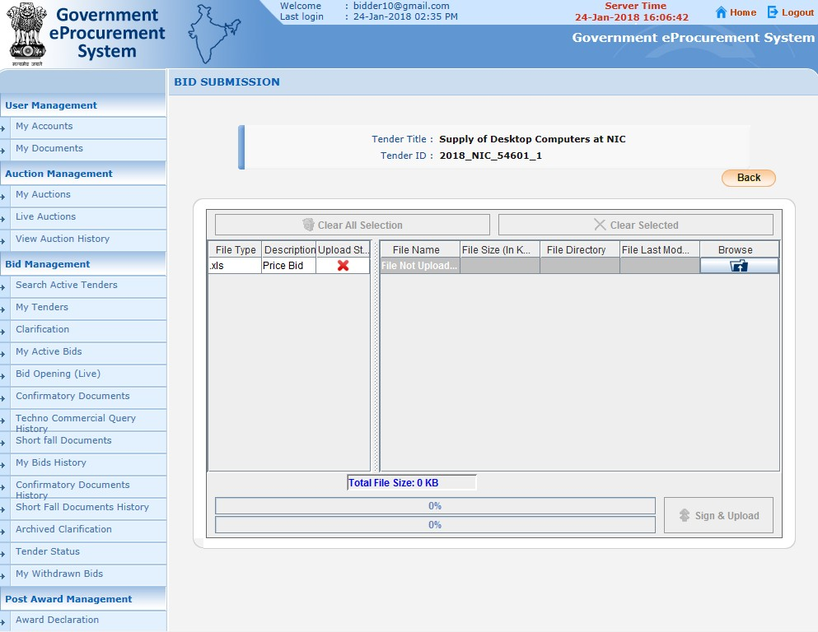

Browse and select file

Slide 48
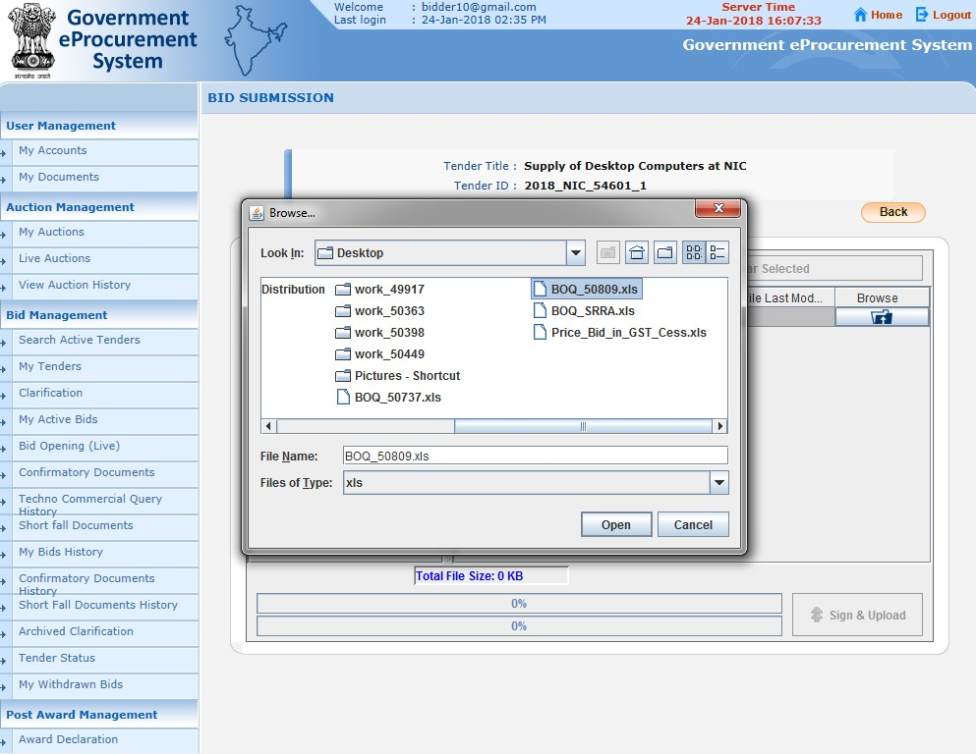

1
1. Select the BoQ file. Make sure prices are filled in the excel.
2.Click Open

Slide 49
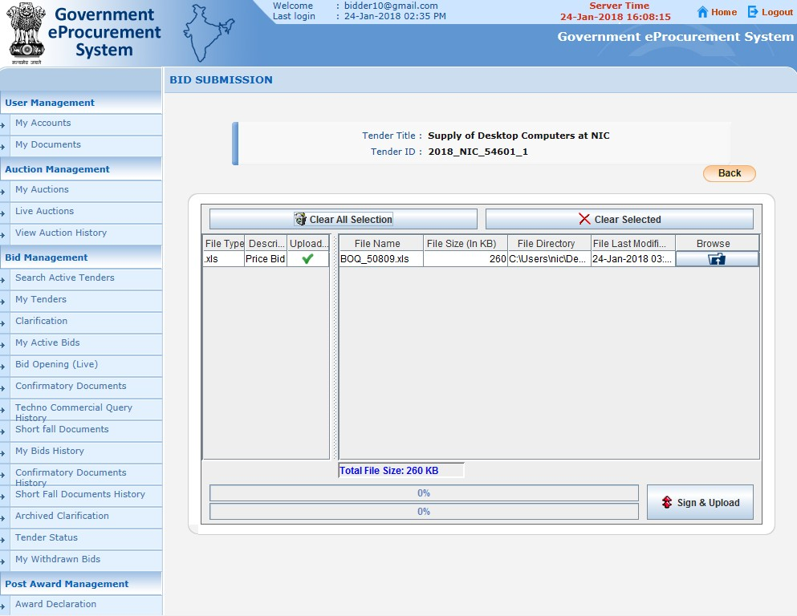

Click Sign & Upload

Slide 50
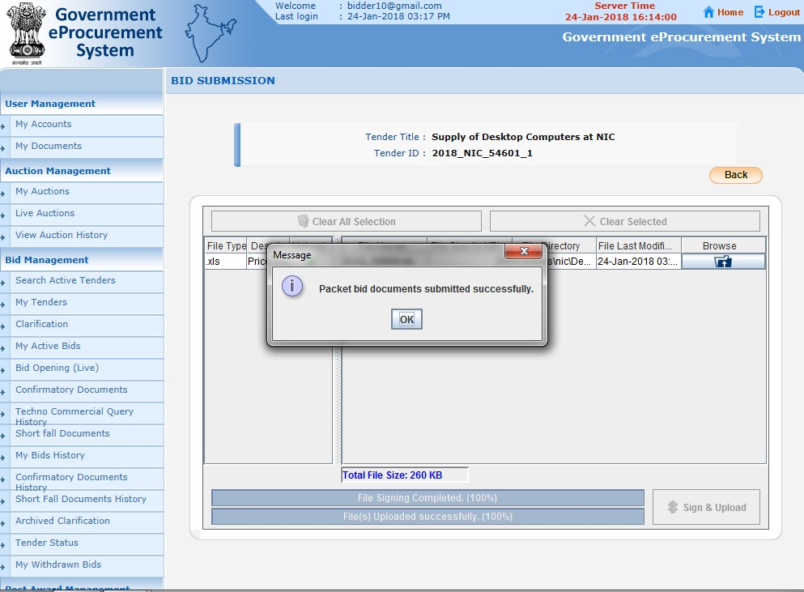
Click ok

Slide 51
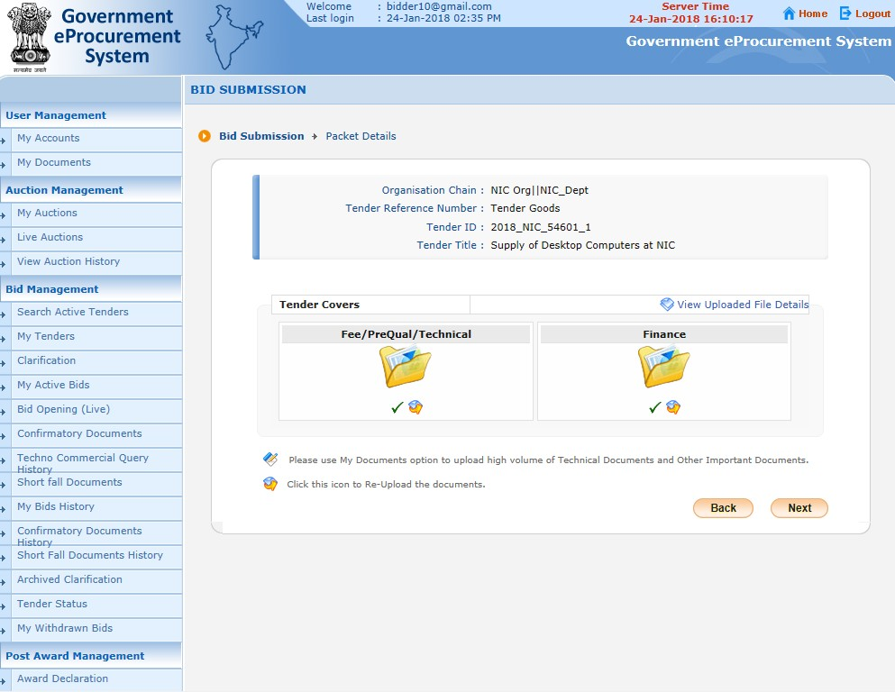


Click here to view uploaded file details
Click Next

Slide 52
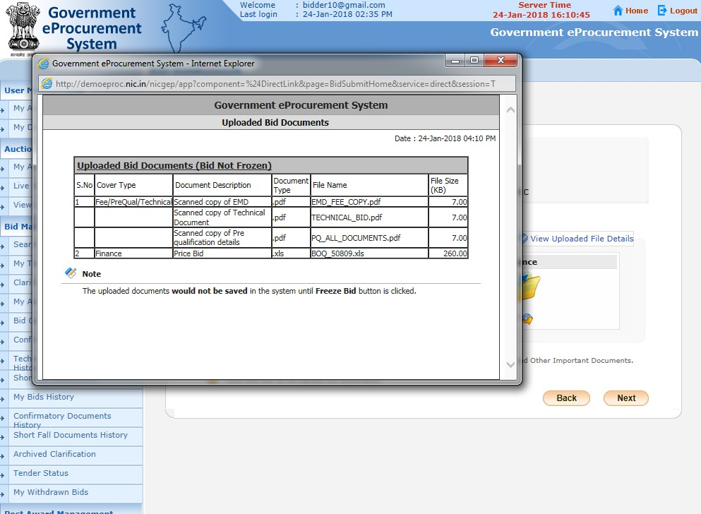
Uploaded Bid document details

Slide 53
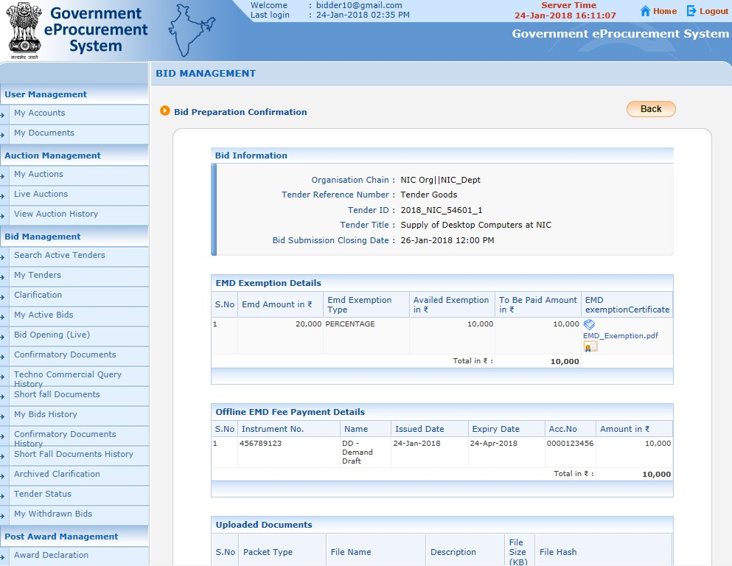


EMD
Exemption details
EMD Fee details

Slide 54
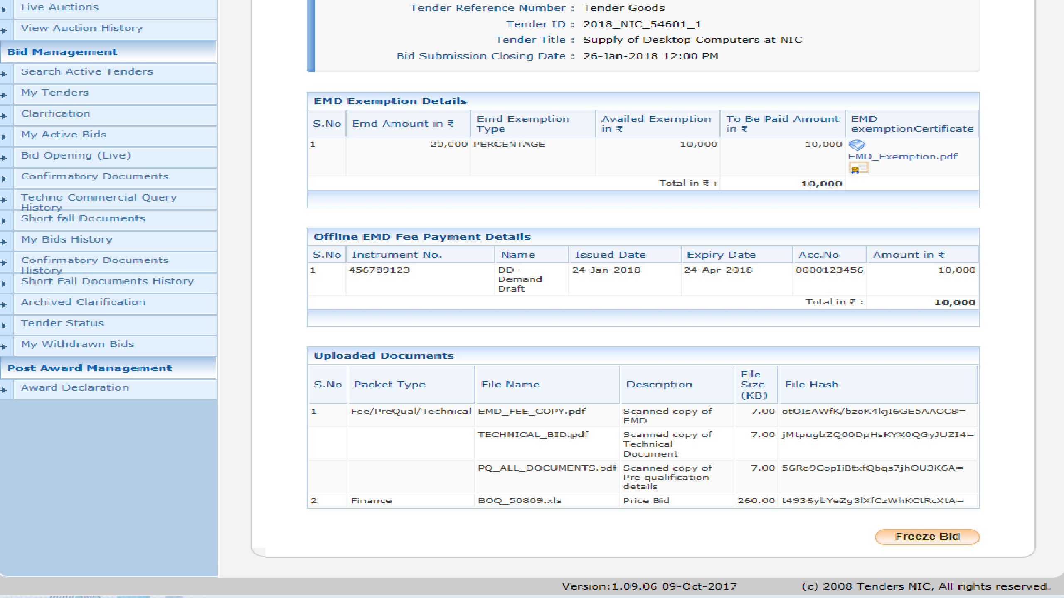


Hash code of the Uploaded documents
Click Freeze Bid Submission for acknowledgement

Slide 55
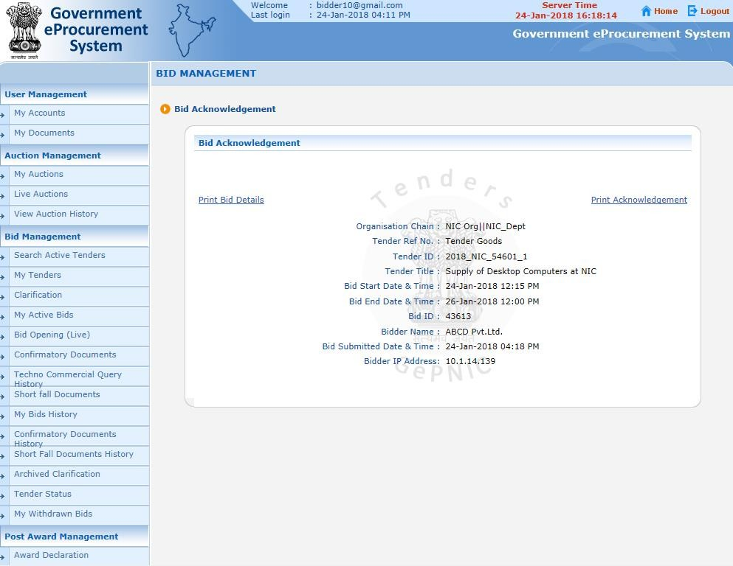

Bid Acknowledgement Page
Click print to take print out of acknowledgement

Slide 56
Thank you
End of Bid submission

